Slide 1
T/Detective Chief Inspector Jason Kew
What are the Police doing about drug related deaths?

Slide 3
What’s the real damage
Drug related deaths are at the highest recorded level UK - 5543 (ONS)
Around 1 in 11 adults aged 16-59 used a controlled drug in the past year (ONS)
Around 1 in 5 (20%) of 16 to 24yr olds used a controlled drug in the past year – That’s 1.3million people (ONS)
14% increase between 2015/16 and 2016/17 in the number of people presenting to treatment for crack cocaine problems in England (Source: NHS digital / NPCC)
In excess of 40k people arrested in the UK for possession offences (MoJ)
There are approx. 300k people registered with Heroin addiction (PHE)
A black person, is 11.8 times more likely to be convicted of possessing cannabis than a white person (Release drugs, Stopwatch, LSE - colour of injustice)

Slide 4
STIGMA KILLS
https://www.youtube.com/watch?v=bdE5kTLve30 https://www.bbc.co.uk/bbcthree/clip/2173a7da-c8e1-42a9-b9d6-e094614ff776

Slide 5
Current Approach
Current strategy of prohibition aims to protect public health, prevent harm to others, prevent the spread of crime with associated drug use, this is not working as drugs are more and more readily available (Clutterbuck, 1995; UK Drug Policy Commission, 2008; Albrecht & Ludwig-Mayerhofer, 2011).
The penalties associated with prohibition are in place to act as a deterrent. The more harmful the drug, the greater the penalty, the greater the deterrent to possession (Husak & De Marneffe, 2005) .
Proponents of prohibition argue that a more tolerant approach to drugs would make it more socially acceptable, which would lead to an increase in usage (Van Dijk, 1998; Korf, 2002).
The government 2017 evaluation of the ‘Drug Strategy 2010’ surmised that:
“there is, in general, a lack of robust evidence as to whether capture and punishment serves as a deterrent for drug use”

Slide 6
The deterrent has already failed for those found in possession of controlled drugs.
When dealt with by way of warning, caution of fine in court, the users do not receive assistance to help them stop using drugs.
Furthermore, there is evidence to suggest that rather than deter persons from further drug use, the stigmatisation of a criminal record marginalises and prevents their reintegration back into society (Collinson, 1993; Buchanan & Young, 2009)
WHY DO WE ARREST?

Slide 7
Portugal – 39 / United Kingdom - 5546

Slide 9
Person in possession of any drug – Not age specific
Seize drug
Check PNC
Record ‘crime’
Now Engage
Diversion booked via an app direct to local drug service
A community resolution applied
Drug service provides feedback of attendance ie to avoid people taking advantage
Person voluntarily attends education/treatment at drug service (outreach is key)
Safeguarding
Intel interview
Additional
Offences?
Diversion is not decriminalisation, although a community resolution is invisible to a standard DBS check (Lammy 2016). Unlimited opportunities for diversion. A gateway for assessment, education/treatment/intervention pathways where appropriate and better outcomes for people found with drugs.

Slide 10
Officer feedback
“I thought it was a good scheme when the training was delivered (& I can be cynical enough about a couple of things we’ve had over the years!)…. I thought it was pretty straight forward and I would definitely use it again.” (Case 20)
“It’s really easy and simple to use. So much quicker than what I would have had to do otherwise…. I would have had to send the drugs off for testing, RUI’d him, it would have been on my screen for 8 weeks. This was really easy. I like it.” (Case 2)
“I have used this a couple of times now…. I have found it really easy and quick. I have also had a thank you from a detainee that I dealt with to say he was sorry for his arrest and feels he was treated fairly.” (Case 24)

Slide 11
Officer feedback
“Recently in West Berkshire I have noticed a decrease in County line activity and in my opinion the diversion scheme is a contributing factor in lowering the demand for Class A drugs, along with other factors such as house closures and pursuit of the suppliers.
I have been speaking with local Class A drug users some of who appear to be in recovery and some, who are using drugs considerably less.
I have noticed the community have also been discussing those who have managed to get clean and I believe it is encouraging others to seek treatment.
The diversion scheme I would suggest is assisting in rapport building within the sub culture as the Police are no longer criminalizing those most at risk and in return it creates a hostile environment to those supplying as the community offer up information to assist law enforcement to reduce the temptation on the street”. (case 26)

Slide 12
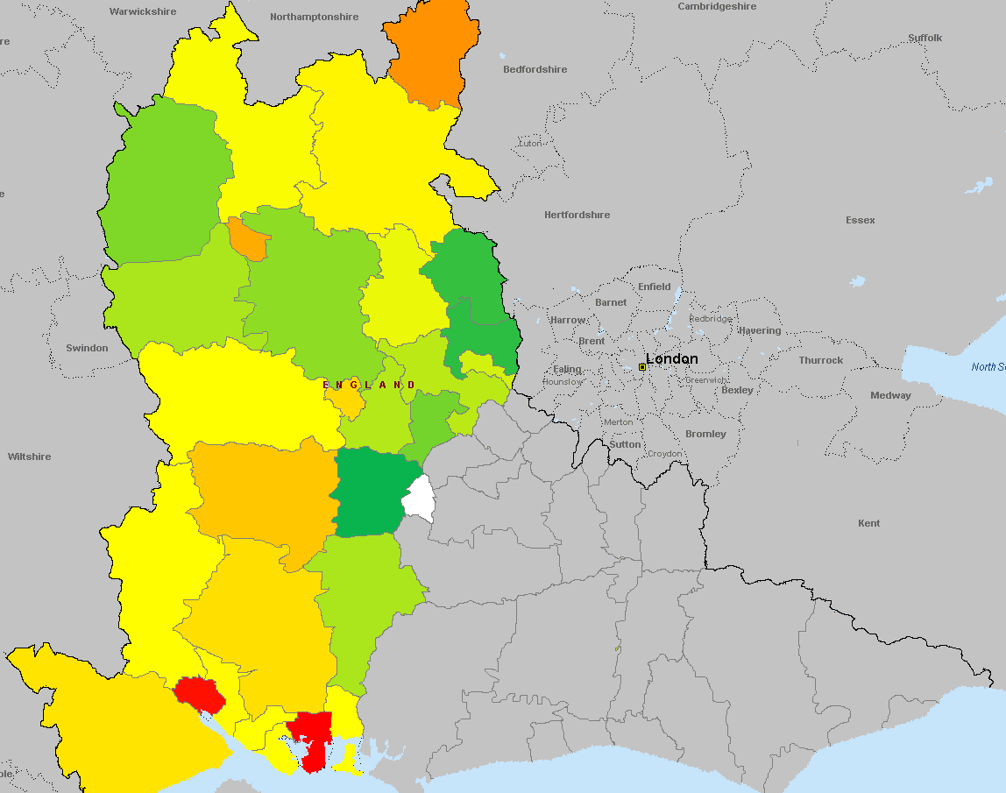
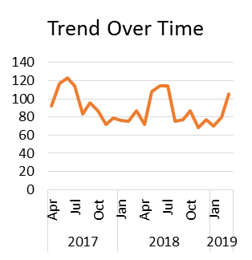
Naloxone Distributions
Data Period April 2017 – March 2019
NB: SCAS data only covers Thames Valley and Hampshire (not including the Isle of Wight)
Portsmouth and Southampton are the Districts seeing the highest number of naloxone distributions. When taking populations into account, the districts of Oxford and Winchester also feature highly.
District (Sorted by # per person) | # of Incidents | 2017 Population | # per 1,000 person
Portsmouth | 323 | 214,718 | 1.50
Southampton | 307 | 252,359 | 1.22
Oxford | 142 | 154,582 | 0.92
Winchester | 88 | 123,789 | 0.71
Gosport | 56 | 85,509 | 0.65
Basingstoke and Deane | 114 | 175,337 | 0.65
Milton Keynes | 169 | 267,521 | 0.63
Reading | 95 | 163,075 | 0.58
Fareham | 54 | 116,219 | 0.46
New Forest | 83 | 179,590 | 0.46
Test Valley | 57 | 123,957 | 0.46
Eastleigh | 60 | 130,498 | 0.46
Havant | 55 | 125,065 | 0.44
Cherwell | 53 | 147,602 | 0.36
West Berkshire | 54 | 158,473 | 0.34
Aylesbury Vale | 65 | 196,020 | 0.33
East Hampshire | 37 | 119,392 | 0.31
Slough | 45 | 148,768 | 0.30
Wycombe | 50 | 174,758 | 0.29
Vale of White Horse | 37 | 131,227 | 0.28
Windsor and Maidenhead | 40 | 150,140 | 0.27
West Oxfordshire | 28 | 109,266 | 0.26
Wokingham | 39 | 164,980 | 0.24
South Oxfordshire | 31 | 139,767 | 0.22
Bracknell Forest | 26 | 120,377 | 0.22
South Bucks | 11 | 69,785 | 0.16
Chiltern | 13 | 95,355 | 0.14
Hart | 4 | 188,484 | 0.02
Rushmoor | 0 | 95,817 | n/a
2136 Incidents

Slide 14
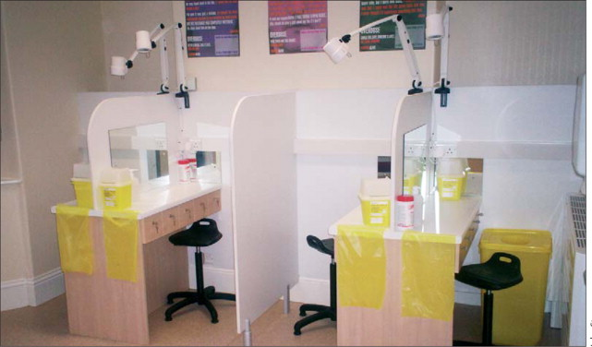
Heroin assisted treatment - UK RIOTT trials – Evidenced that the heaviest heroin using 10 to 15% consumed 50 to 66% of illicit street heroin - By prescribing medical diamorphine to this group (127) crime reduce - 30 days prior to entering treatment there were 3907 unrecorded crimes committed by this group - The total number of crimes committed in the 30days prior to the six month interview had reduced in all groups to a total of 849 (78%)

Slide 16
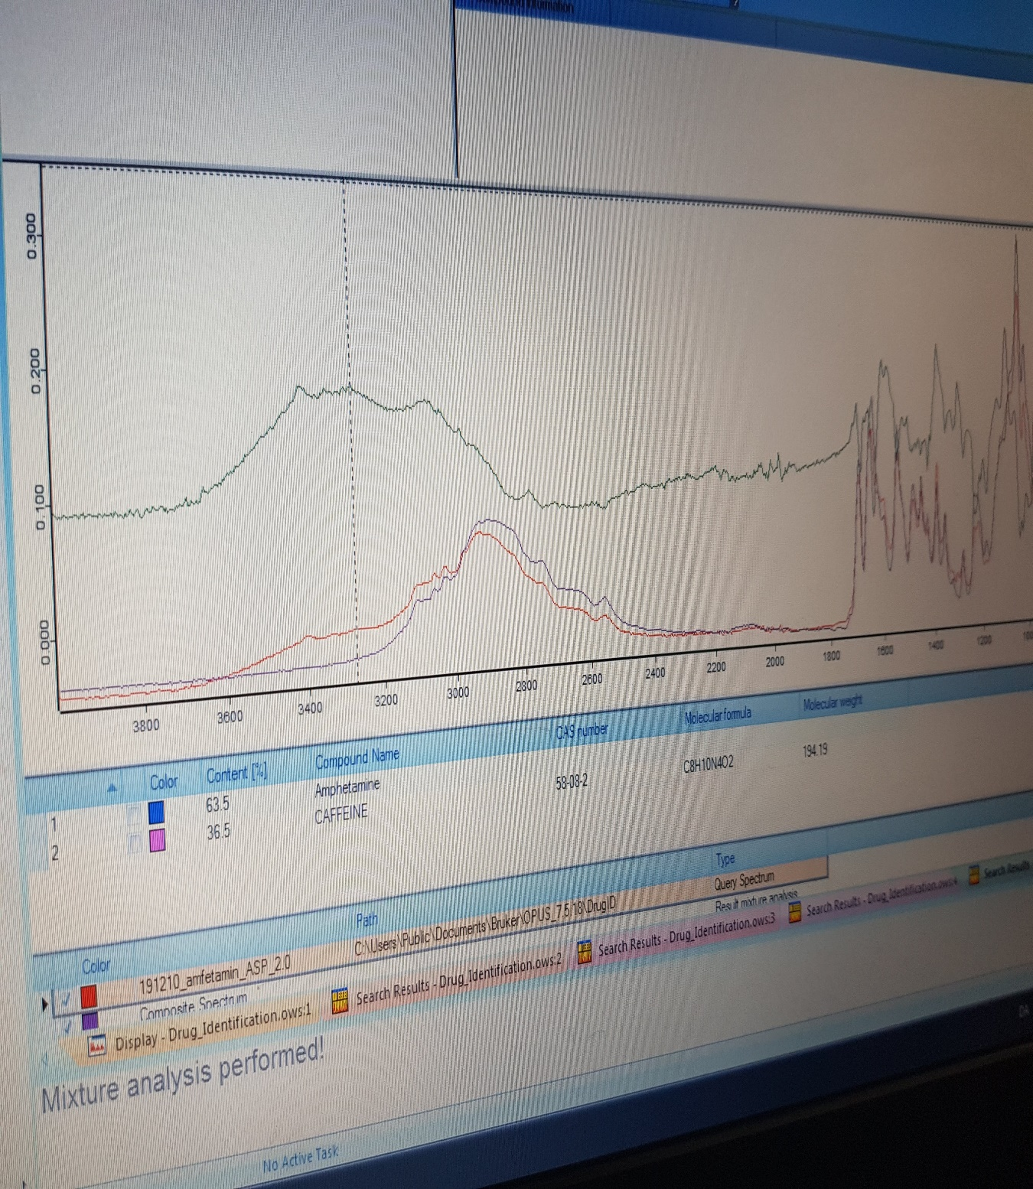

Slide 18
The Homeless man…. What the nurse described… and what the Police say…

Slide 19
Supervised injection facilities
What are they? = safe spaces
Why do communities need them?
Political position – Honeypot effect?
How do you Police them? – Diversion?
Legal position – S8 MDA, S44,45,46 SCA
Public interest test? MoU? Lawfully audacious

Slide 20
Thank you…
But… Please don’t listen to me!
Listen to the evidence…
Together, we need to act now..
Support not punish

Slide 21
Bibliography
Albrecht, G., & Ludwig-Mayerhofer, L. (2011). Diversion and Informal Social Control. Berlin: De Gruyter Inc.
Bean, P. (2014). Drugs and Crime. London: Routledge.
Best, D. H. (2003). Getting by with a little help from your friends: The impact of peer networks on criminality in a co hort of treatment-seeking drug users. Addictive Behaviours, 597-603.
Buchanan, J., & Young, L. (2009). The War on Drugs - a war on drug users? Drugs: Education, Prevention and Policy, 409-422.
Caulkins, J., & Kleiman, M. (2011). Drugs and Crime. In M. Tonry, The Oxford Handbook of Crime and Criminal Justice (pp. 275-320). Oxford: Oxford University Press.

Slide 22
References
Clausen, T. S. (2017). Similarities and differences in victimization risk factors for nonoffending and offending substance users. Victims and Offenders: An internation journal of evidence-based research, policy and practice.
Clutterbuck, R. (1995). Drugs, Crime and Corruption: Thinking the Unthinkable. London: Palgrave Macmillan Limited.
Collinson, M. (1993). Punishing Drugs. British Journal of Criminology, 382-399.
Engelsman, E. (1989). Drug policy and the management of drug-related problems. British Journal of Addictions, Vol. 84, 211-218.

Slide 23
References
French, M. M. (2015). Low self-control and the victim - offender overlap a gendered analysis. Journal of Interpersonal Violence, 2076.
Greenwald, G. (2009). Drug Decriminalisation in Portugal. Washington: Cato Institute.
HM Government. (2017, August 30). An evaluation of the Government's Drug Strategy 2010. Retrieved from www.gov.uk: https://www.gov.uk/government/publications/understanding-organised-crime-estimating-the-scale-and-the-social-and-economic-costs
Hughes, C. (2009). Capitalising upon political opportunities to reform drug policy: A case study into the development of the Australian "Tough on Drugs-Illicit Drug Diversion Initiative2. International Journal of Drug Policy, Vol. 20, No. 5, 432-437.

Slide 24
References
Husak, D. (2003). Four Points about Drug Criminalization. Criminal Justice and Ethics, 3-11.
Husak, D., & De Marneffe, P. (2005). The Legalization of Drugs. Cambridge: Cambridge University Press.
I., S., Clausen, T., Skurtveit, S., Abel, K., & Bukten, A. (2017). Similarities and differences in victimization risk factors for nonoffending and offending substance users. . Victims and Offenders, 1-16.
Korf, D. (2002). Dutch coffee shops and trends in cannabis use. Addictive Behaviours, Vol. 27, No. 6, 851-866.

Slide 25
References
NHS. (2017, August 10). ‘Alcohol and Drugs Prevention, Treatment & Recovery - Why Invest?’. Retrieved from Public Health England: http://www.nta.nhs.uk/uploads/alcoholanddrugswhyinvest2015.pdf
Oteo, P. B. (2015). Criminal involvement and crime specialization among crack users in the Netherlands. European Addiction Research, 53-62.
Polk, K., Alder, C., Muller, D., & Rechtman, K. (2005). Early intervention: Diversion and Youth Conferencing: A national profile and review of current approaches to diverting juveniles from the criminal justice system. Canberra: Australian Government Attorney-General's Department.
Public Health England. (2017, January). HM Government. Retrieved from An Evidence Review of the outcomes that can be expected of drug misuse treatment in England: https://www.gov.uk/government/uploads/system/uploads/attachment_data/file/586111/PHE_Evidence_review_of_drug_treatment_outcomes.pdf

Slide 26
References
Ruback, R., & Clark, V. W. (2013). Why are crime victims at risk of being victimized again? Substance use, depression, and offending as mediators of the victimization-revictimization link. Journal of Interpersonal Violence, 159-185.
Stevens, A. B. (2007). The victimization of dependent drug users findings from a European study. European Journal of Criminology, 385-408.
UK Drug Policy Commission. (2008). The UK drug classifcation system: issues and challenges. Retrieved from UK Drug Policy Commission: www.ukdpc.org.uk/wp-content/uploads/Briefing%20-

Slide 27
References
UK Treasury. (2015). Treasury Cannabis Regulation. Retrieved from Treasury: www.tdpf.org.uk/sites/default/files/Treasury-cannabis-regulation-CBA.pdf
Van de Wijngaart, G. (1991). Competing perspectives on drug use. Amsterdam: Swets and Zeitlinger.
Van Dijk, J. (1998). The narrow margins of the Dutch drug policy: A cost-benefit analysis. Netherlands: European Journal on Criminal Policy and Research.

