Slide 1
Drugs Policing and Harm Reduction in England & Wales
Matthew Bacon
m.bacon@sheffield.ac.uk
SIPR/DRNS Event
Thursday 16th January 2020

Slide 2
Harm Reduction Policing
‘The policing of drug markets is usually conceptualised primarily as a matter of law enforcement – drug dealers and people who use drugs are breaking the law, and the role of the police is to reduce such law breaking. However, the wider purpose of policing is to ensure the safety of the community by reducing harms to its members’ (Stevens 2013, p1).
‘Harm reduction policing engages communities in a manner that builds trust, addresses the needs of individuals using drugs, and reduces adverse effects of drugs and drug enforcement. This involves recognizing that people unable or unwilling to abstain from illicit drug use can still make positive choices to protect their own health, the health of their families, or their communities; and that police can work with other community or health actors to help facilitate this outcome and advance public safety’ (Krupanski 2018, p4).

Slide 3
How Can The Police Save Lives? Krupanski (2018)
Create space for, rather than interfering with, harm reduction services:
Needle and syringe programs
Medication-assisted treatment
Substance analysis and drug checking projects
Supervised drug consumption rooms
Drop-in centres
Prioritize saving lives in cases of overdose or crime victimization:
Do not charge or arrest at overdose scenes
Carry and support distribution of the opioid overdose antidote
Extend protection from arrest to those who report being victims of or witnesses to crimes
Work with public health partners to create ‘health hubs’ around drug users and overdose victims

Slide 4
Policing Retail Drug Markets Stevens (2013)
There should be increased recognition that the level of harm is more important than the size of the market.
Police services and policy makers should use tactics that are experienced by the community as being fair, lawful and effective.
There should be increased appreciation that some enforcement-led approaches, including short-term crackdowns and large scale stop and search, are unlikely to produce sustainable reductions in drug sales. They may actually increase levels of violence and health harms and reduce police legitimacy.
Potentially effective tactics include decriminalisation/depenalisation, ‘pulling levers’, focused deterrence, diversion to treatment and other problem-oriented, partnership approaches.

Slide 5
Alternatives to Arrest and Prison Caulkins and Reuter (2017, p113)
‘Conceptually we would like to achieve a given target reduction in abuse while minimizing arrests and seizures, but all too often the criminal justice system slips into an emphasis on maximizing, not minimizing, those process outcomes. Remembering that a principal purpose of prohibition is to protect people—and their families—from their own bad choices may insulate against a mentality of having to burn the village in order to save it. For conventional crimes, justice is served by punishing the criminal; but if the justice system can steer an individual away from drug use without incarceration, that is the true win.’

Slide 6
Does it Work? Krupanski (2018, pp5-6)
‘Harm reduction policing has benefited drug users, families, communities, and law enforcement personnel themselves.
Research has shown that harm reduction policing can reduce the rates of HIV and hepatitis C, reduce needlestick injuries or other occupational hazards for police, increase links for populations living on the streets to ongoing services (including drug dependence and medical treatment), reduce court and prison overcrowding, decrease recidivism and crime rates, and increase law enforcement’s ability to focus on serious offenders.
Law enforcement has also noted the beneficial impact of harm reduction policing on their relationships with community members and the uptick in the perceive trust and legitimacy of their agencies among the communities they serve.’

Slide 7
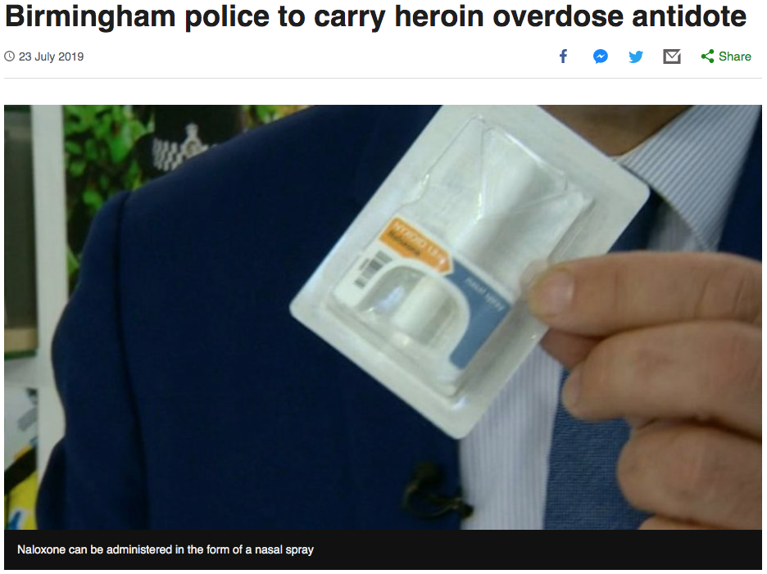
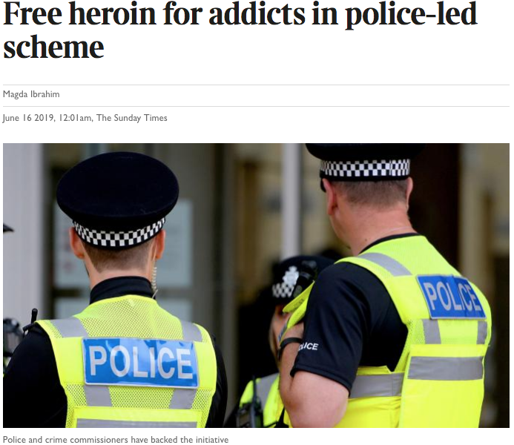

Slide 8
(New) Models of Diversion
Pre-arrest/street diversion schemes – Avon and Somerset’s Drug Education Programme and Thames Valley’s Drugs Diversion Scheme Pilot
Deferred prosecution schemes – West Midland’s Turning Point, Durham’s Checkpoint, Avon and Somerset’s Call-In, Cleveland’s Divert, North Wales’ Checkpoint Cymru and Thames Valley’s Drugs Diversion Scheme Pilot
Custody intervention schemes – the Metropolitan Police’s DIVERT

Slide 9
Research Methods
Interviews with police experts and the key actors behind the development and implementation of innovation and reform in the policing of drugs (n=73)
Interviews with non-police experts on drug laws and drug policy reform (n=8)
Content and discourse analysis of Police and Crime Plans and drug strategy documents
National survey of police forces

Slide 10
Rationale
“I think overall it's about preventing reoffending and that’s the solid, you know, overall outcome. However, it is about changing people’s direction and putting people onto a better path, so it enables them to be better citizens and enables them to contribute to society to their potential. So by preventing reoffending, then that ticks my policing aim, but I have a social sort of weight on it too. Those things are only achieved I think by genuine people that work on the programme … genuine referral pathways, genuine opportunity – none of this half-baked lip service crap that can happen.”
“It is about people who take drugs being given the opportunity to have some education around their drug use and around the health consequences and to sort of do that in a way that doesn’t criminalise them and give them a criminal record.”
“[S]ending someone down the criminal justice route does not help to reduce crime, does not help to reduce their problem with drugs and does not help to reduce the cost to society … [W]hat the current approach does is it feeds directly into almost keeping that going, keeping the reoffending going. So you know, by sending someone to a prison where they continue to access drugs or actually start a drug habit which is even worse, it’s going to continue that cycle.”

Slide 11
Pushing the Boundaries
“I think it’s a test of what we can do within the current legal framework because obviously if we did decriminalise, we wouldn’t be talking about any of this … [I]t is using the evidence which is available and been tested and evaluated and debated over and over about enforcement and how it's not working, it has no impact, so therefore, what can we do to reduce drug related deaths? And it’s that, you know … and we need to do something quite quickly as well, so we do need to push the boundaries about how far we can go to emulate a model that works, Portugal, within our framework.”
“I can and do act in the face of opposition from the Home Office … [T]he annoying thing is that none of what I’m doing is forbidden, but they will not give me explicit permission to do a lot of it … I’m quite happy to defy Government … if I thought I was doing the right thing … I’ll do that to the very best of my ability and I’ll make the best judgement and take the blows and read the Daily Mail every so often just to see how well I’m doing.”

Slide 12
Driven Individuals Drive Change
“A lot of these initiatives, both in the PCC’s offices and in the police forces, are dependent on people standing up and leading and driving the activity, people who really believe in it, people that want to pave the way, people that want to change people's perceptions. When a key player, or a key voice, in selling that message, is no longer part of the organisation, it's very big shoes to fill, it will lose momentum really quickly.”
“We had a perfect storm at the time; so you had me and my service from a provider’s perspective, we had [Drug Strategy Manager], who had his own experiences in his family of drug use, so he was invested, and [member of Problem Solving Team], incredibly passionate about supporting drug users. It was a perfect storm of people that made other people sit up and listen and then once that happened more people were going ‘Yeah let’s do this, let’s get on board’, and the buy-in from police officers – I briefed over a hundred police officers across the Force around [diversion programme] and the buy-in has been superb.”

Slide 13
Personal Circumstances and Professional Opportunities
“My approach changed actually. I could say up to about the year 2000 my view was probably a very police view in that drugs, it was a war to deal with drugs, it was a pain in the backside … That changed … not through the job but because of personal circumstances where one of my immediate family has become addicted to drugs, to hard drugs, and that effect and the impact of that on, not just her, but the rest of the family and particularly myself made me question a lot more around how we police drugs and how we deal with them, which then led to me taking up the post as drugs lead in 2006 because I thought maybe I could maybe do something about it … [I]t’s still a massive impact on my whole family, on a day-to-day basis, and so if you multiply that by the hundreds and thousands and maybe millions of people going through the same thing, my view was we have to do something different then, don’t we, because it ain’t working. So my views changed through a personal circumstance and then I’ve been lucky enough to have the opportunity to try and do things professionally as well.”

Slide 14
Turning Points
“I got called to a sudden death in the top floor of a hotel room … and there was a young lad probably about 19 years old, really handsome, really good looking lad, he was dead sitting in a chair in this room and he had injected himself with heroin and died instantly … I just kind of remember that was the first time that I had seen somebody who wasn’t, you know, that kind of pitiful heroin addict that you kind of see on the streets and it was really difficult to associate, you know, a nice lad from a nice background and what his family must be feeling, and that kind of started to change my view.”
“There were two arrests that I made for cannabis which I still remember to this day and there is a bit of a guilt complex about them to be honest with you … [I]t kind of struck me at the time that that one arrest has actually kind of now shaped somebody’s whole kind of future.”
“[My daughter] went off to a festival, her first festival, came back really, really ill … [W]e kind of questioned her a bit more and it transpired that she had taken her first ecstasy, had a bad reaction and spent the whole festival having emergency medical treatment … [K]nowing many, many stories of kids taking ecstasy at festivals and being found in their tents, it just made me go cold and really reinforced my kind of view that had been developing anyway that actually we need to do something completely different about drugs and this isn’t about enforcement around users.”

Slide 15
Budget Cuts, Demand Management and Evidence-Based Policing
“What the cuts and the reduction of budget is doing is driving us towards thinking differently because we haven’t got enough resources. Secondly, there is this move towards evidence-based policing on the back of the budget cuts … I think policing is getting more focused on those activities that are most effective and I think because of that it creates a context where we are asking questions about some other stuff we do and have always done and thinking well, why have we always done this? So we are asking the question, even though it’s against the law to be in possession of drugs, why at [Police Force] are we arresting 3,700 people and what value is that adding?”
“The cuts to police budgets have forced different police forces to look at how they could be more innovative to drive down their demand long term and I think for a lot of areas, including drugs, that’s around changing the focus and putting more focus on early intervention and prevention – the idea being that that will lead to reduced rates of crime. So I think it's round demand management.”

Slide 16
Target Culture
“When I joined we were very much a detection culture and I remember sitting in a briefing thinking it’s like being in a sales job here, I am having to hit targets. I literally had to say how many people I had arrested, how many detections I had … We had a spreadsheet up on the screen in front of us and it was a red/amber/green system and if you hadn’t hit your targets by the end of the month, well, you were going to be in trouble, so you would go out and arrest people when really was arresting them the right thing to do, probably not … We’ve started to see a change from that culture of detection chasing into actually let’s think about this in a very different way around crime reduction and long term problem solving.”

Slide 17
National Trends, Priorities and Agendas
“[T]he conversation around drugs in some respects has become more hard hitting … greater awareness of the links around serious organised crime, the County Lines agenda, more and more often the drugs trade is being linked with the increases in serious violence that we are seeing in the media, knife crime and young children on young children ... [T]here’s also been the shift away from focusing just on enforcement to public health approaches and that does sit, I think, alongside the increased awareness of the vulnerability associated with some of this, so the child criminal exploitation being something that is becoming more and more of a focus of many agencies’ work.”

Slide 18
Challenges
“The reputational risk that the [diversion programme] will result in [police service] being perceived as leading the way in the decriminalisation of drug possession.”
“The biggest challenges for me have been around how it was commissioned and also the out of court disposal regime changes and the impact that has got the potential to have and the timing of it.”
“There is no law that allows the police to say we will prosecute you unless you abide by these conditions and ethically there are, I mean there are you know strong ethical grounds to challenge that kind of structure that the police have put in place … because in essence the police is becoming judge and jury and enforcing that through a threat that has got no legislative basis.”

Slide 19
Getting Buy-In
“So internally, it would include the area where we are doing the pilot, which means the senior management team in that place, it means buy-in from the inspectors, it needs buy-in from that whole, all of the officers on that LPA, from the ones that are going to be implementing the diversions to their managers to make sure that they are doing it … to the inspectors to make sure that it is being pushed, to the custody sergeants, to the evidential review officers that are kind of separate from that; criminal justice as a department, so they look at our processes, so we need their kind of approval because it is sort of critical, if we are doing stuff outside the law or we are doing stuff that’s different they need to at least be aware of what we are doing; our comms and media department, so obviously a lot of queries come into that; the chief’s management team … the drugs lead within the Force; the PCC’s office because there is a political aspect to that. There is also a funding aspect. The drugs commissioners, the community safety partnerships that fund the drug service provider, the drug service provider themselves …. councillors in that area because it is a political issue as well, potentially the MP from that area … Public Health England, the Ministry of Justice, the NPCC, who we have spoken to, certainly the Drugs Parliamentary Committee have assisted in providing the support directly to the PCC’s office and the Chief.”

Slide 20
Cultural Stasis and Resistance
“Not all officers are fluffy or have any fluffy tendencies you know, there are still officers out there that would refuse to [divert] anybody because they just don’t agree with it … But that’s police officers you know, they have their own discretion and they can make their own decisions.”
“Two officers came down into custody shortly after that briefing … and one said: ‘I think it’s brilliant, I really hope it works, I have never really seen it like this before and I think it is a really good idea’. The next one that comes in: ‘Well why don’t we just decriminalise everything then not have a police force?’ I thought, okay, two people, same briefing, same team, couldn’t have more different views.”
“There are some people, senior people in this organisation who think this is an utterly dreadful idea and do not understand why we would want to stop arresting people for possession of drugs. It tends to be people towards the end of their service but they just – and I’ve been quite surprised by this – but they just don’t get it.”

Slide 21
Pragmatism, Persuasion and Personality
“I can't speak for other police officers in terms of how they view how we should deal with people that use drugs but definitely from a sort of pragmatic point of view I think people are fully behind it because it is saving police officers’ time, saving us and the organisation money as well so yeah, very positively received.”
“I’ve gone into other custody suites where I put [diversion programme] in and I’ve had a big hand in my face, literally like where you are the hand is right in my face going, ‘I’m an ex-hostage negotiator, I’m a specialist firearms officer, I’ve been in the job for 30 years, why are we helping these people because I don’t see why we should be helping them’ and I think because I can say well [diversion programme] actually does this, this and this to fit in with this policing objective, people then start seeing it differently.”
“It takes a while for things to become custom and practice but I think you know when you have got people like [name] leading it, it’s very easy for people to get swept up by his enthusiasm and you don’t really notice it but it can change your perspective.”

Slide 22
Education and Knowledge Exchange
“I’ve always had a view of [drug use] being more of a public health issue rather than an offence per se … I am probably now in my views the same as I was when I was 21 at university … Yeah I guess an event was at university, I read about the Swiss heroin assisted programme, I think that was quite transformative in my views of drugs, I remember thinking about the issue quite a lot at that time and I don’t think it has really changed.”
“I think the PCC’s views and the drugs summit where we listened a lot to Public Health have actually reframed some of the ambition, which has got people talking about different aspects … [T]he recommendation around … the increase take up of naloxone, for example, I approached that with some scepticism to begin with and actually have spent some time educating the Force … wrote a piece on our internal intranet so officers would understand what it was about, what it was for.”

Slide 23
Recovery Stories
“We took a lot of the ambassadors and people out of the recovery centre … so we had 180 detectives who they came to speak to, custody sergeants who they came to speak to and people were like: ‘Oh I thought he was dead, where did they go?’ … [T]hey can speak in a really articulate way, really analyse themselves … and why they are where they are now … [T]hat storytelling is really powerful around that aspect of, you know, drugs, alcohol and mental health and what made them change and actually what would have made them change if they had had that opportunity and how could the police actually create those opportunities more or, you know, just see the problem in a different way, because a lot of our staff had given up hope.”

Slide 24
Recommendations for Reform Krupanski (2018, p6)
Knowledge and integration of harm reduction tools and approaches
Communication and positive relationships with affected community members and other service providers working in the same area
An emphasis on the protection of safety, health, and dignity of community members (including people who use drugs) through tools other than arrest and detention
Introduction of operational guidance and policy to improve practices related to drug users and possession of drugs for personal use
Officer performance metrics and incentives that support both public safety and health-oriented objectives
Organisational culture that reinforces the move from being a force to a service, and assumes a broader view of the impact of law enforcement on society

