Slide 1
Graphic Design for Academic Posters
Peter Buwert
p.buwert@napier.ac.uk
@peterbuwert
(with special guest Ryan Gosling)

Slide 2
What do you want to know?

Slide 5
No one in the real world cares about graphic design

Slide 8
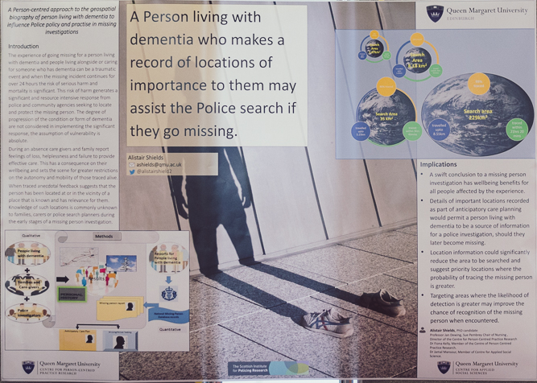

Slide 9
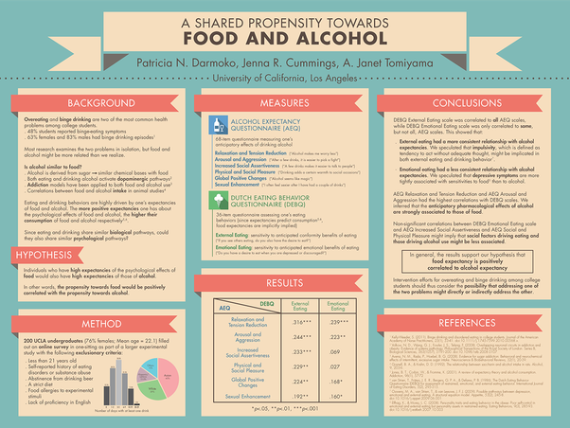

Slide 10
#BetterPosters

Slide 11
1: It’s not about how it looks It’s about how it works

Slide 12
2: Unless you are a graphic designer… You are not a graphic designer Please stop doing crazy things

Slide 13
New Balance = Putting images behind text

Slide 14
3: Less is not more But it is better
“Perfection is achieved, not when there is nothing more to add, but when there is nothing left to take away.” Antoine de Saint-Exupery
You don’t need to show everything: QR code or link to full content

Slide 15
PRACTICAL TIPS

Slide 16
Typefaces/Fonts
Serif
Sans Serif
No Thank You
Are you kidding me?

Slide 17
Most important things biggest and highest
Line things up (grid)
Margins
Spaces
Stand out (by keeping things simple)
Black sans serif text (Arial, Calibri, etc.)
Never put text on top of images/background textures
Don’t add extra “design”

Slide 18
HEIRARCHY
What is most important to communicate?
Viewer journey

Slide 19
Title Abstract Literature Review Methodology Data Images Analysis Discussion Conclusion

