Slide 1
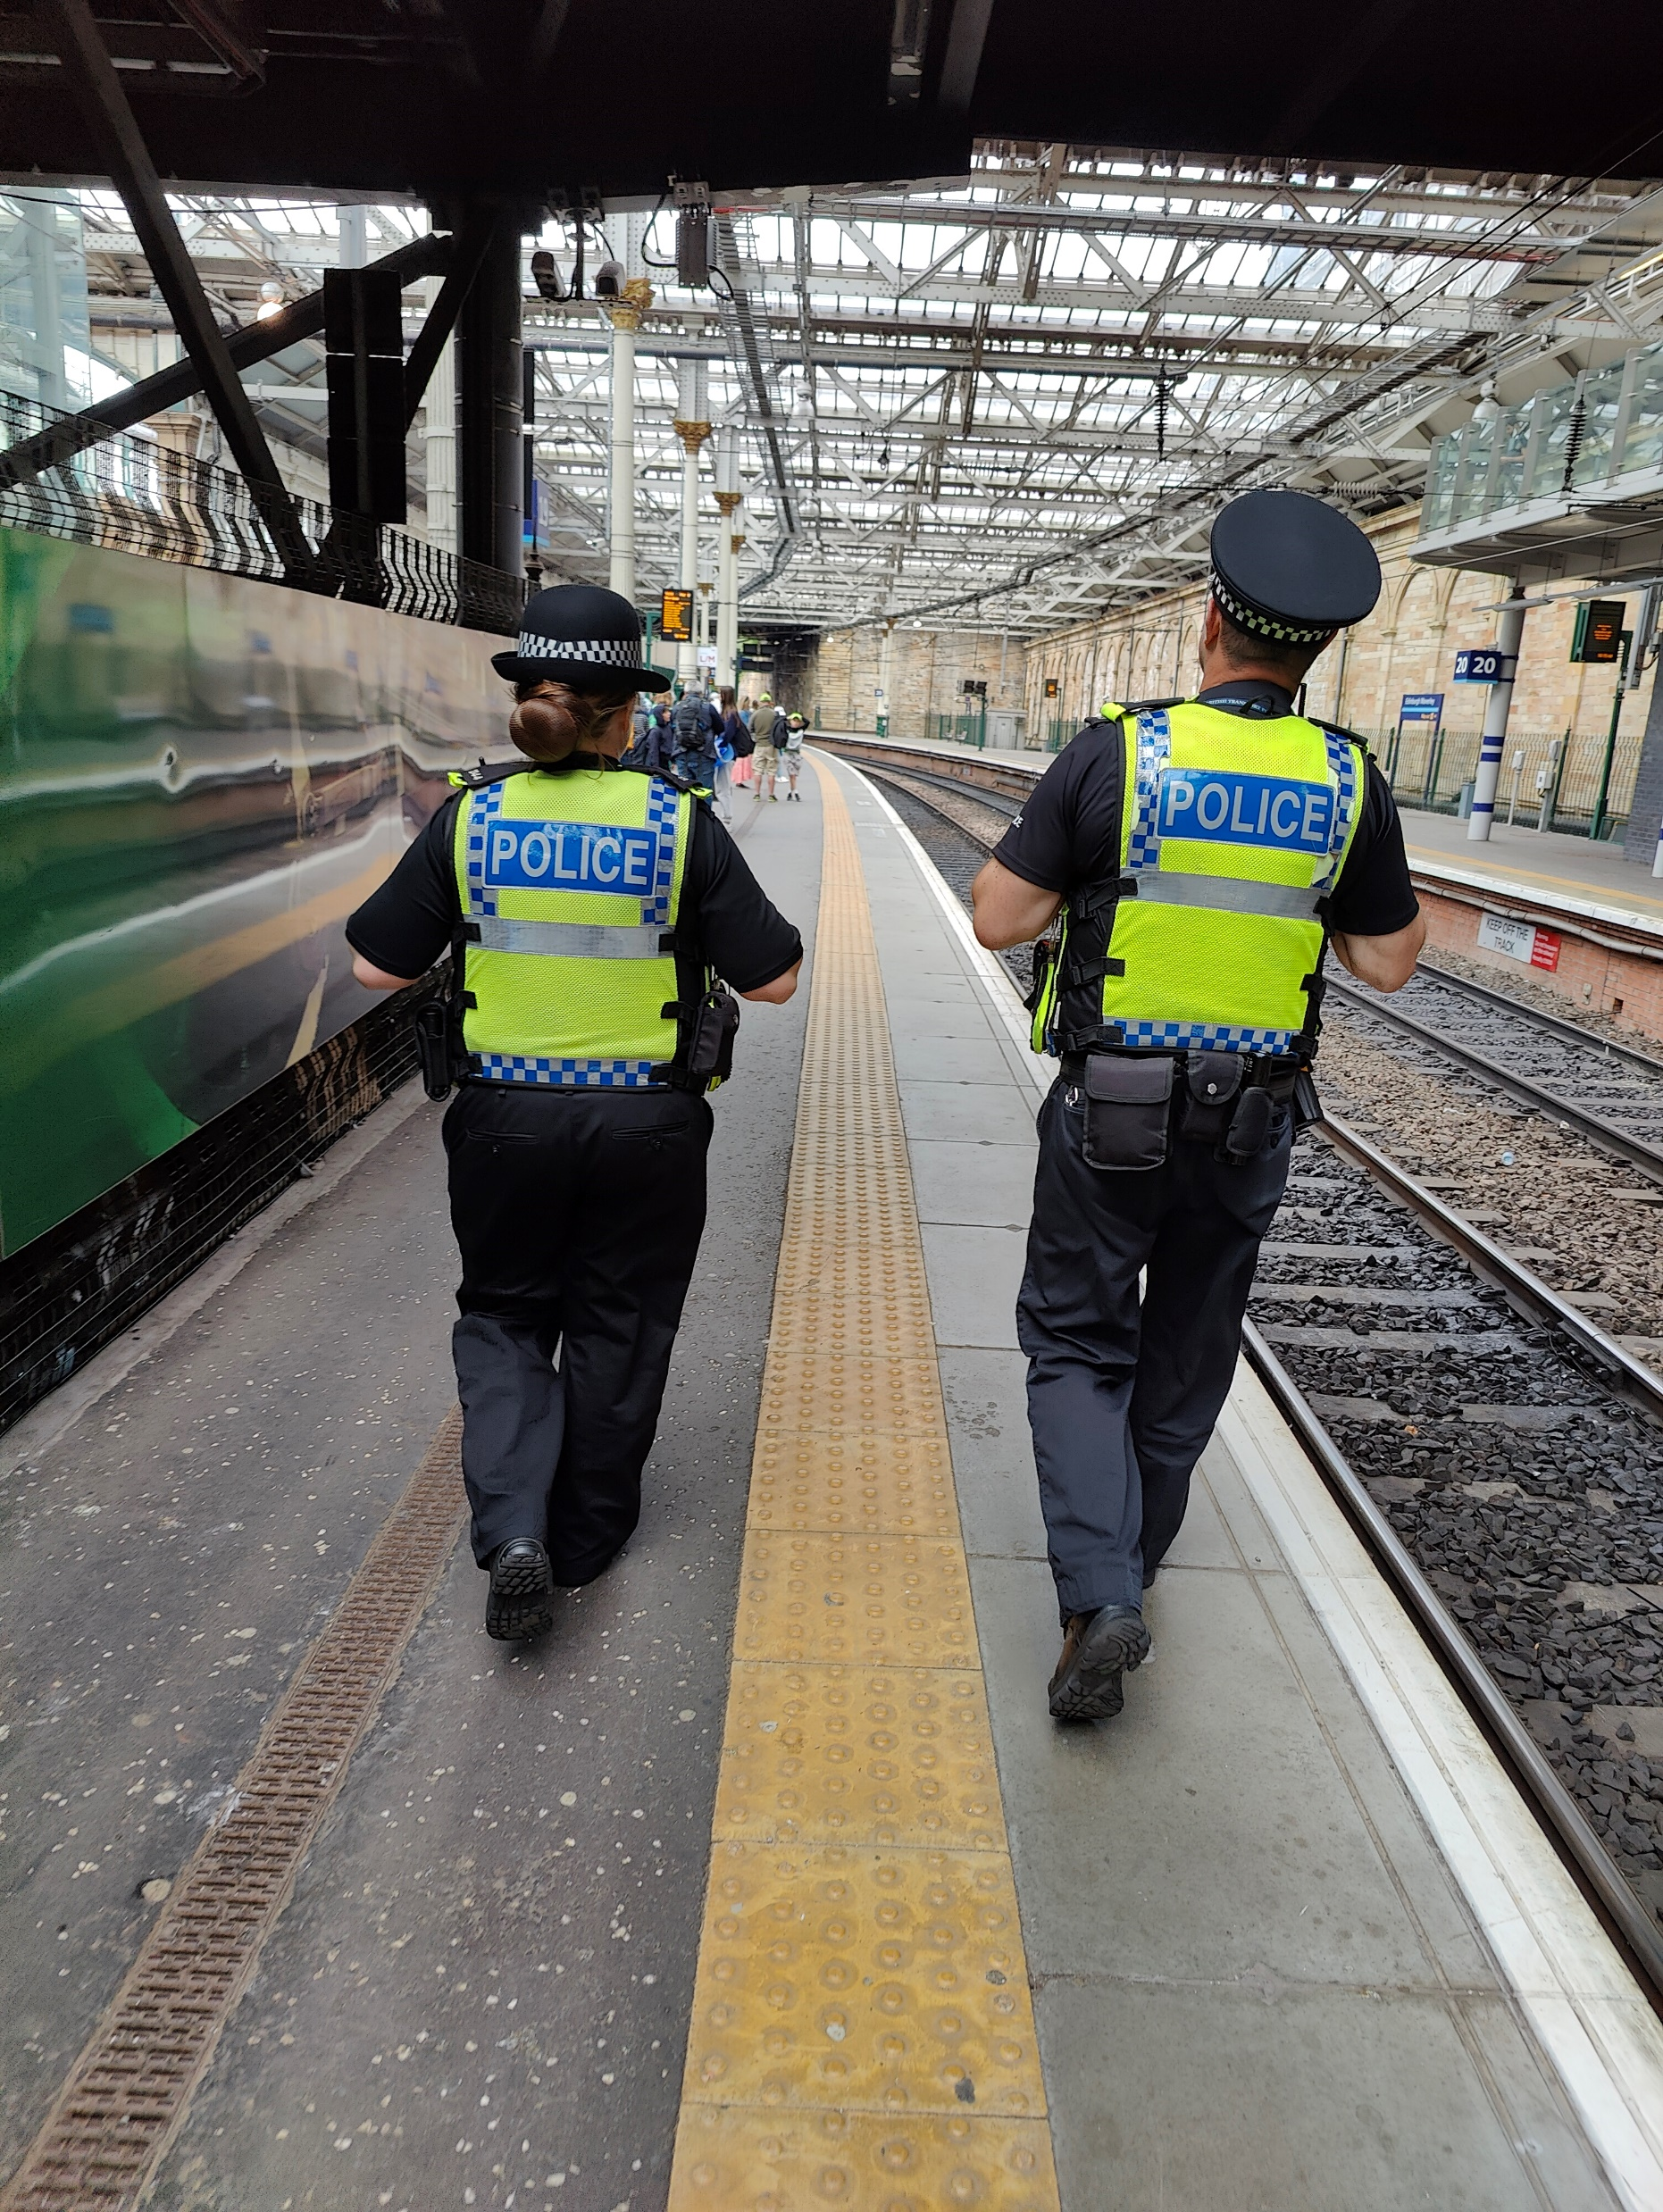
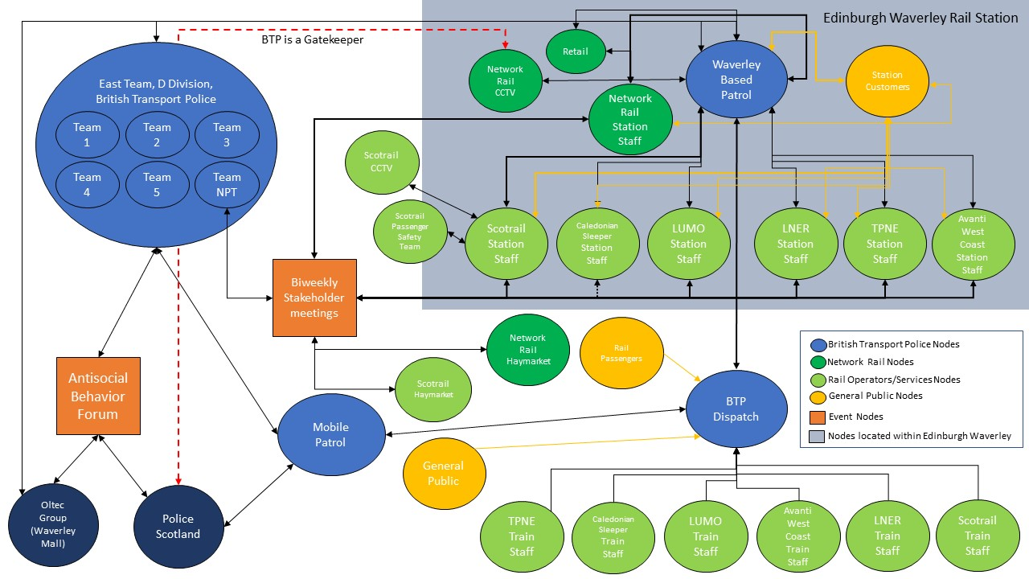
Emotions & Security: A Study of Emotional Labour Within the British Transport Police Operating at Waverley Train Station
Robert Holland (PhD Candidate, r.j.holland@sms.ed.ac.uk)
*Research is funded by the University of Edinburgh and the University of Glasgow Jointly Funded PhD studentship*
A Nodal Map of Edinburgh Waverley’s Security Ecosystem.

