Slide 1

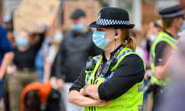
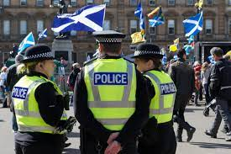

Presenter: Dr. Mahnoz Illias, Ph.D. Research Student
Understanding the Health & Wellbeing of Female Police Officers in the UK
Understanding the Interplay between Organisational Injustice and Health and Wellbeing of Female Police Officers:
A Meta-ethnography
Existing Literature
Procedural
Injustice
Distributive
Injustice
Secondary Data Analysis
“When I ﬁrst got hired, I had one of my sergeants tell me: “Just so you know, I’m a sexist, like don’t be offended by it, but I’m a sexist”.
Female Officer
Exploring Lived Experiences
Relational
Injustice
Gendered
Injustice
Submitted to: Policing: a Journal of Policy and Practice
Supervisors: Dr. Evangelia Demou, Prof. Kathleen Riach

