Slide 1
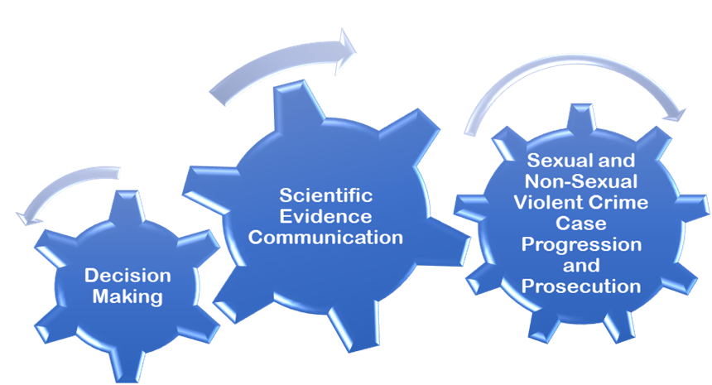

Phase One
Rape Crisis Scotland Interviews
Phase Two
Citizen Science Decision-Making Project
Phase Three
Citizen Science Evidence Evaluation Project
Simon-Lewis Menzies MSc, BSc (Hons)
PhD Researcher

