Slide 1
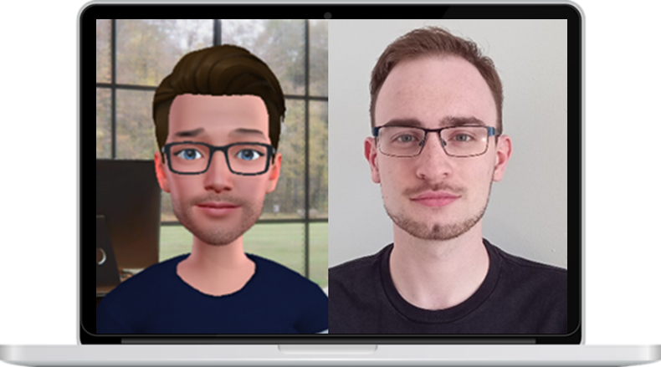
Using Avatars in Investigative Interviews with Young people
Sam Conway, PhD Student, Abertay University Dundee
Aim(s) of Project:
This project will test the suitability of ‘avatars’ as forensic interviewers for children and young people
This project will compare virtual avatars with human interviewers over MS Teams
Study One (Online survey)
8-18-year-old participants
Crime scenarios
Measure the preferred disclosure recipients
Male/Female/Non-Binary
Human/Non-Human
Online/Face to Face
Study Two (Episodic Recall)
Mock Eyewitness Interview
11-18-year-old participants
Measure free recall
Measure suggestibility to leading questions
Study Three (Disclosure)
NICHD-inspired interview
i.e., ‘’tell me everything about…”
Measure the quality of disclosure
Measure the quantity of disclosure
Study Four (Focus group) - PLANNED
Scottish Police officers/Social Workers specialised in interviewing children and young people
Avatar ‘Product testing’
Twitter: @SamConway97
Email: s.conway1500@abertay.ac.uk

